Slide 1



Spatio-temporal clustering of hydrological extreme
Sidhan V V
PhD Student
Indian Institute of Technology Delhi
Supervisor: Prof. Manabendra Saharia
Department of Civil Engineering
Indian Institute of Technology Delhi
29 Sept 2024

Slide 2
INTRODUCTION
Streamflow plays a major role in drinking water, agriculture, hydropower and ecosystem
Any variability from expected streamflow will affect the overall water budget of an area.
Extreme variations leads to droughts and floods which pose significant risks to infrastructure and human life.
Their impacts of this floods/ droughts t is more hazardous when
The events co-occur over a large area (Spatial connectivity)
Consecutive events occurs over a time window (Temporal clustering)
Understanding the spatial and temporal patterns of these extreme events is crucial for effective water resource management and disaster mitigation.

Slide 3
INTRODUCTION
Hydrological extremes, such as floods and droughts, often exhibit temporal clustering, where successive events occur in close succession, amplifying their impacts.
Additionally, spatial connectivity between different regions can lead to synchronized hydrological extremes, further exacerbating water crises over large areas
Analyzing the co-occurrence of these events helps in identifying underlying atmospheric drivers, such as large-scale climate oscillations, land surface conditions, and regional weather patterns
A comprehensive understanding of these relationships can improve early warning systems, enhance predictive models, and support adaptive water management strategies in a changing climate.

Slide 4
Streamflow variability drivers
Precipitation
Temperature
Solar radiation
Enhance/ depreciate moisture transport
Atmosphere
ENSO, PDO, AMO
Climate variability
Alters energy partition
Warming the atmosphere
Climate change
Streamflow variability
Land
Alters water budget
LULC degradation
Soil
Geology
Human activity
Water consumption

Slide 5
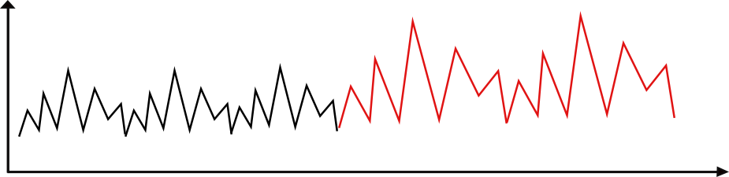
Challenges
It is challenging to unravel the variability due to natural oscillations and climate change.
A continuous timeseries analysis such as trend test, Mann kandal, correlations etc wont work here as hydrological timeseries are non-stationary.
Temporal drought clustering should be considered in trend analyses where drought-rich periods at the beginning or end of a time series might lead to the detection of artificial decreasing or increasing trends, respectively
Q1. Is this a trend or a part of natural cycle ??
Q2. If this a trend – Is it due to land changes or due to atmosphere changes (global warming)
PDO +
PDO -

Slide 6
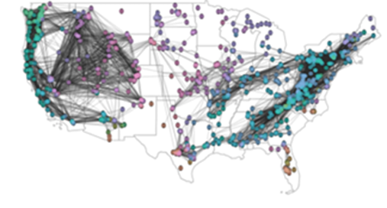
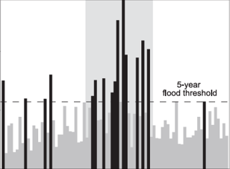
Spatial connectivity and temporal clustering of hydrological extremes and their land-atmospheric drivers
Hydrological Event Synchronization
Spatial connectivity
Temporal clustering

Slide 7
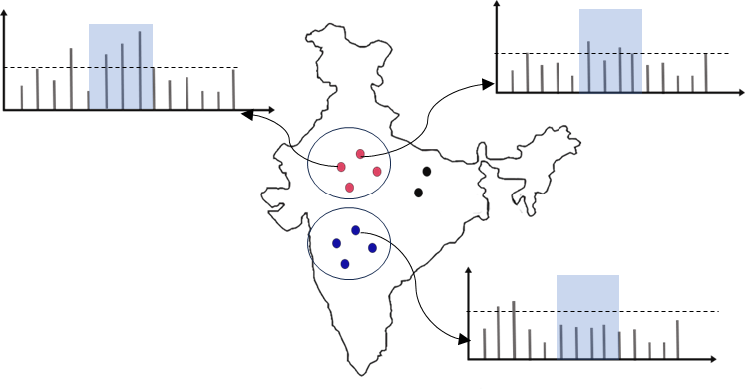
Scopes
Temporal clustering
Investigate if there is any flood/ drought clustering in streamflow timeseries over India
Study the factors governing the clustering – ENSO, EQUINOO etc
Identify the stations with similar event co-occurring over the time.
Evaluate if there is any hydrological dipoles
Analyse the physical processing governing their co-occurrence
A
B
C

Slide 8
Objective
To investigsa

Slide 9
Slide 1
Literature Review
Drought flood types
Temporal clustering
Spatial-connectivity
Physical Linkage
Different Method
Reference:

Slide 10
Slide 1
1
Flood-drought type
3D drought characterization
Drought centroid tracking
POT approach
Flood event are classified into 5 categories based on shape of hydrograph
Fischer et al., 2022
Feng et al., 2024
LR
Lun et al., 2020
Reference:

Slide 11
Slide 1
Flood categories
After extracting flood event based on POT of monthly timeseries, it can be categories to 4 groups based on shape of hydrograph or the governing factor
Here we require the daily timeseries of streamflow, precipitation, p-pet, snowmelts, soil moisture etc etc
So, we can attribute flood based on the factors governing it
Reference:

Slide 12
Slide 1
2
Temporal Clustering
sas
Assume flood is a random poison process
We evaluate the independence of poison process over time.
Different categories of floods is there depending on rainfall runoff behavior, snow melt etc
Lun et al., 2020
Lui & Zhang., 2017
Fischer., 2022
LR
Manuela & Stahl, 2023
Chagbas et al., 2022
Hydrological droughts show substantially more temporal clustering than meteorological droughts because of memory introduced through different storage and land-surface processes
Droughts‐rich periods are more frequent in shorter time scales (several years to one decade) and flood‐rich periods in longer time scales
Reference:

Slide 13
Slide 1
Temporal clustering
It is challenging to unravel the variability due to natural oscillations and climate change.
A continuous timeseries analysis such as trend test, Mann kendal, correlations etc wont work here as hydrological timeseries are non-stationary.
It is challenging to attribute trend to lulc changes or global warming
Reference:

Slide 14
Slide 1
2
Temporal Clustering (Methods)
Poison distribution
Cox regression model (intra-annual clustering)
Inter-annual clustering (Dispersion index & Kernal occurrence estimation)
Applied dispersion & Replays coefficient on streamflow, E-E_{p} and precipitation data
Boot strapping for significant test
Lui & Zhang., 2017
Manuela & Stahl, 2023
LR
Lun et al., 2020
Scan statistics
Poisson modeling
Reference:

Slide 15
Slide 1
Different methods of temporal clustering
Ripley’s K
Dispersion Method
Reference:

Slide 16
Slide 1
Different methods of temporal clustering
Firstly, the index of dispersion, which quantifies the departure from a homogeneous Poisson process, is investigated
Reference:

Slide 17
Slide 1
3
Spatially connected events
Spatial flood dependence varies regionally and seasonally
Land‐surface processes are crucial in shaping the spatiotemporal characteristics of flood events apart from meteorology
Brunner et al., 2020
LR
Reference:

Slide 18
Slide 1
Physical linkage
Utilized vertical velocity
Lui & Zhang., 2017
LR
Reference:

Slide 19
Slide 1
Potential Objective
sa
Whether and how hydrological droughts cluster temporally in different hydro-climatic regions across the globe
Whether and how the temporal clustering of hydrological droughts varies between natural and regulated catchments,
how the temporal clustering of hydrological drought relates to the clus tering behavior of meteorological drought
We hypothesize that flood clustering in Germany is mainly caused by catchment memory effects along with intra- to inter-annual climate variability, and that decadal climate variability plays a minor role
Check the case of consecurigve flooding event kerala, 2018,2019
Based on the usual iid (independent, identically distributed) assumption of flood frequency analysis, the T-year flood quantile is assumed constant in time. However, temporal clustering may introduce serial correlation in the flood time series and invalidate the independence assumption
Reference:

Slide 20
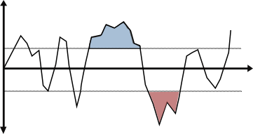
Slide 1
Potential Objective
Investigate the regions where there is multiple drought coming together or flood come after drought or normal situation is coming after drought etc.
Temporal dependency
Analyze the asymmetry in flood-drought generation process
Clustering
Investigate if there is significant connectedness in flood events over different stations over India
To explore whether the connectedness is predominant in some specific season
Investigate whether the hydrological connectedness is more than meteorological
Identify seasons and regions where precipitation is insufficient to explain the spatial dependence of floods, where land-surface process must enhance or reduce spatial dependency
To unravel the role of land-surface process over meteorological in flood connectedness
Spatial
co-occurrence
Reference:

Slide 21
Slide 1
Potential Objective
Mean precipitation during flood
Mean temperature during
Drivers
Reference:

Slide 22
Slide 1
Potential Objective
sa
Date | Station A | Station B | Station C | Station D | Station E | Station F
01/01/2024
01/01/2024
01/01/2024
Reference:

Slide 23
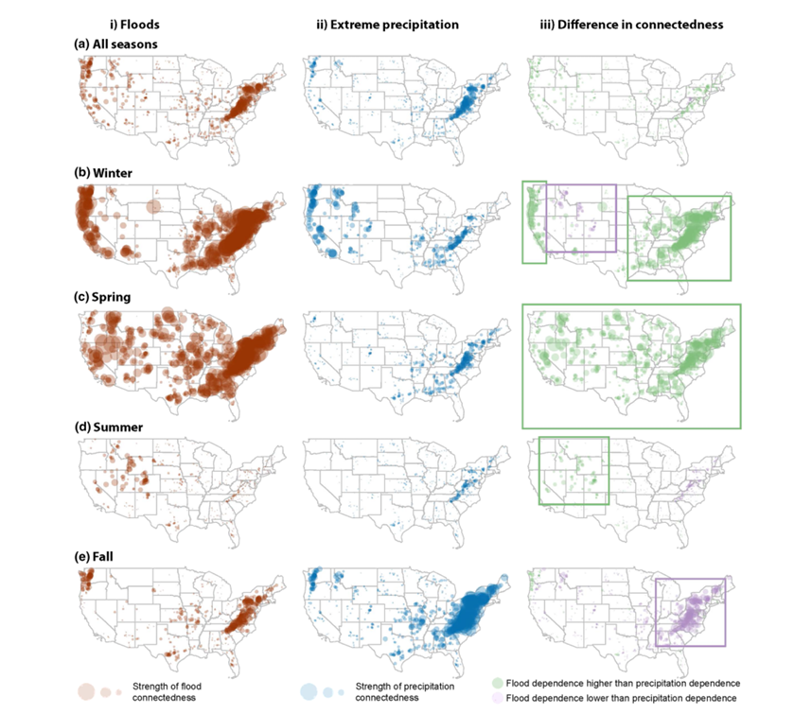
Slide 1
Potential Objective
sa
Whether and how hydrological droughts cluster temporally in different hydro-climatic regions across the globe
Whether and how the temporal clustering of hydrological droughts varies between natural and regulated catchments,
how the temporal clustering of hydrological drought relates to the clustering behavior of meteorological drought
The finding that spatial flood dependencies are governed by both spatial precipitation dependencies and land‐surface processes highlights the importance that these processes must be realistically represented in physical/hydrological models and are present in the initial and boundary conditions used to drive these models
Reference:

Slide 25
Slide 1
DATA
DATA | SOURCE | Papers
Human data | ISIMIP2b | Wang et al., 2024 (Anthropogenic climate change..)
Reference:

Slide 26
DATA BRANCHING
NO | DATA | Time resolution | Spatial resolution
1 | ILDAS | 1948-2022 (Daily) | South Asia
2 | Gauge station | Random (Daily) | India
3 | PET (GLEAM) | Monthly | World

Slide 27
DATA BRANCHING
ILDAS_station_indices
ILDAS_indices_trend.nc
ILDAS_station_streamflow
Gauge_indices_trend.nc
Select the ILDAS grids matching with gauge station.
Create the streamflow station netcdf
Calculate drought flow and wet flow indices
Trend analysis for each season for all grids has been calculated
Quadrent-based trend classification
ILDAS Outputs
Trend_analysis
Preprocessing
Identify the grids satisfying the condition of minimum 30 years of data etc
Modify the gauge information csv.
Combine the gauge data of different station to .nc.
Calculate the dry and wet flow indices and save as .nc
Gauge data
Metadata.csv
NO | DATA | Time resolution
1 | ILDAS | 1948-2022
2 | Gauge station | Random
3
IMD-gauge(i)csv’s
Gauge_info_p.csv
Gauge_streamflow.nc
Gauge_indices.nc

Slide 28
Data preprocessing Gauge
Processed data
1. Modification of start and end datea as they are currently based on stream level.
Gauge_info_p : Start date & end date corrected
Stations subsetted based on criterie
Metadata.csv : it contains all the station information : station name, data period length, lat, lon etc
2. Based on the criteria's,the total stations of around 1160 is subsetted to 243
Gauge_streamflow & Gauge_indices
The separate station csvs are merged into a single .nc
IWM-gauge-1.csv : it contains the timeseries of streamflow and level
Level data columns are removed and the index are modified according to streamflow .
Criteria (Trend analysis)
There area lot of missing data in the time series and all the station doesn’t have sufficient data to do trend analysis
Minimum length 30 years
Minimum end period 2010
Total entries/expected entries > 0.8 (bcoz all the dates in b/w starting and end dates doesn’t have data. So expected entries = total length if all dates have data

Slide 29
Data preprocessing ILDAS data
Processed data
ILDAS station streamflow.nc
1. Extract the data only for those grids where gauge stations are location
ILDAS CALIBERATED ROUTING OUTPUT (Daily)
Merged into a single xarray dataset
Calculation of streamflow index (drought flow and flood flow)
ILDAS station Indices.nc
2. Grid wise data analysis
This file is so huge so that memory error will come when we load the data or do any computation. So
MEMORY ISSUE !!

Slide 30
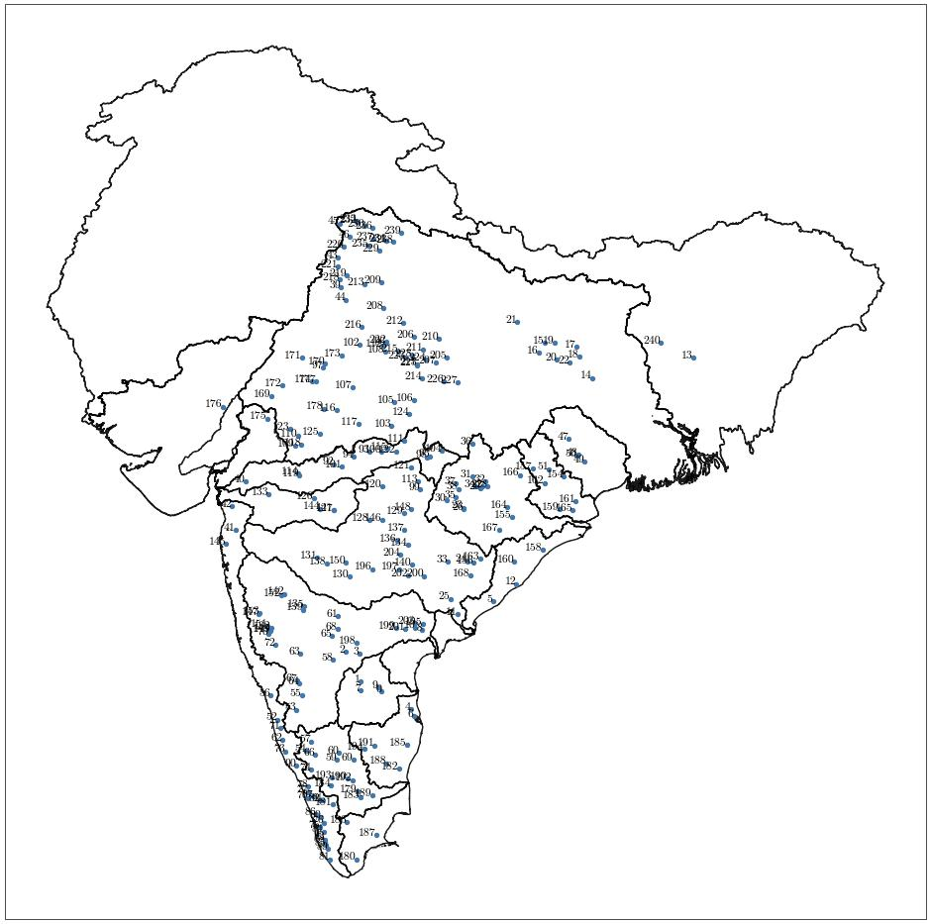

Slide 31
ANALYSIS STRUCTURE
Data conversion :
Data synthesis
Data scanning : Investigated the flaws or discreprencies in RE data
Final code : Sorting all the data inconsisties and producing preprocessed outputs
0.Datapreprocessing
1. Checks
Gauge data consistency
ILDAS vs Gauge data
2.Basic statistics
Timeseries visualization
Covariance among stations
3. Trend Analysis
LIS output are in kg/m^2/s. It is a daily average. We Average this daily average over all days in each month to get monthly average. Finally we have the monthly data of each LIS forcing. LIS*60*60*24*30 = mm/month

Slide 32
2_Checks
Here we checked the nan values,
1. Gauge data scanning
Number of zeroes values
1. Distance between Guage and ILDAS grids
2. Gauge vs ILDAS comparison
2. Streamflow and streamflow index correlation
Drt flow always nan values or zero. Why?
2. Drtflow flood flow statistics

Slide 33
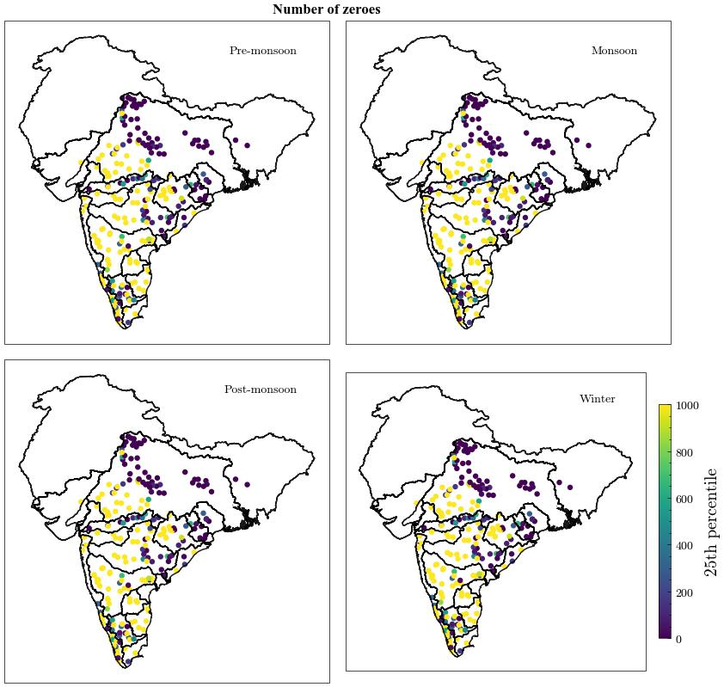
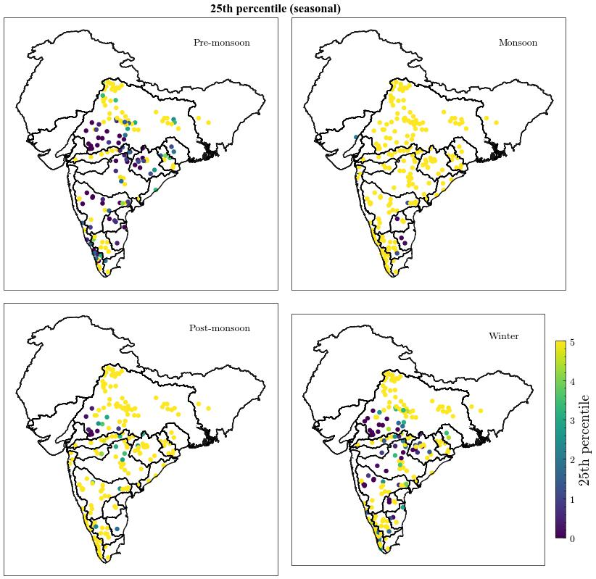
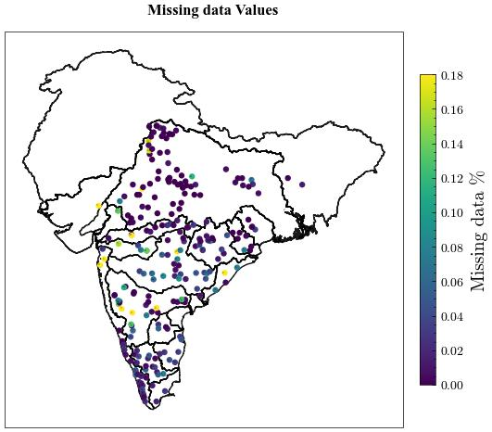
Results – gauge data consistency

Slide 34
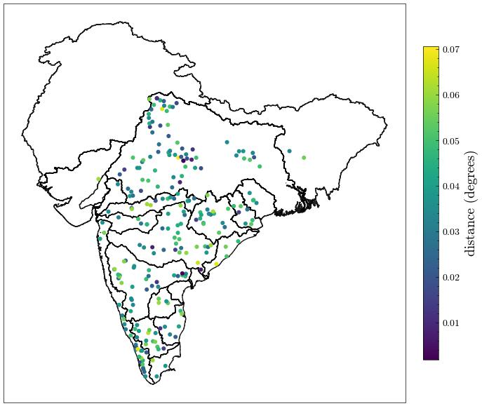
Results – ILDAS vs Gauge
ILDAS output is gridded while gauge output is station-wise. So we select those grids corresponding to the location where the gauge exists. The grid might not exactly coincide with the gauge station; in that case, the nearest grids are taken.

Slide 35
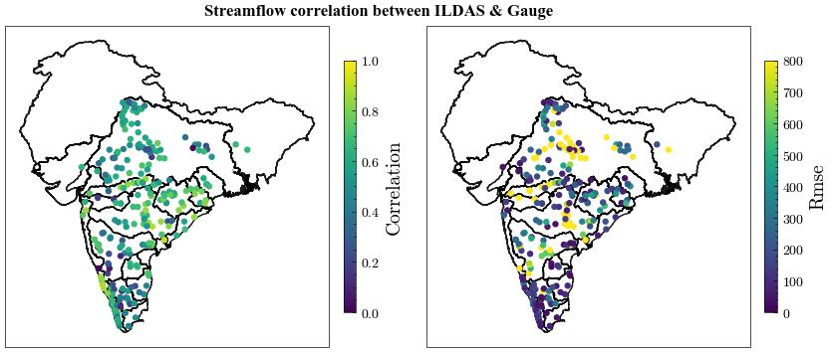
Results – ILDAS vs Gauge

Slide 36
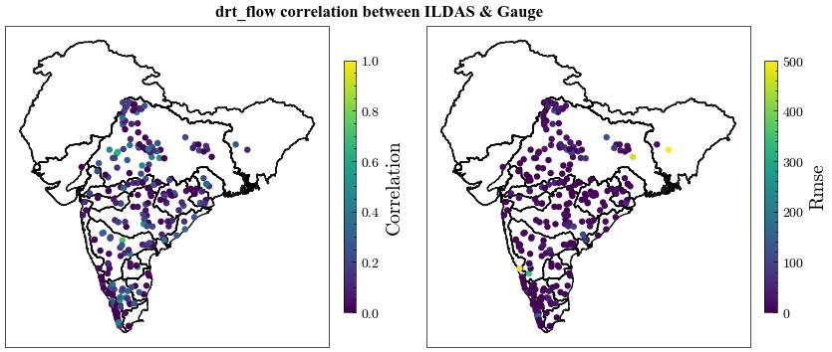
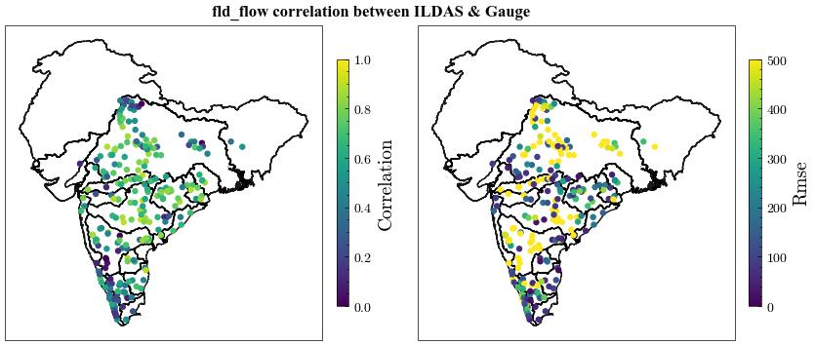
Results – ILDAS vs Gauge

Slide 37
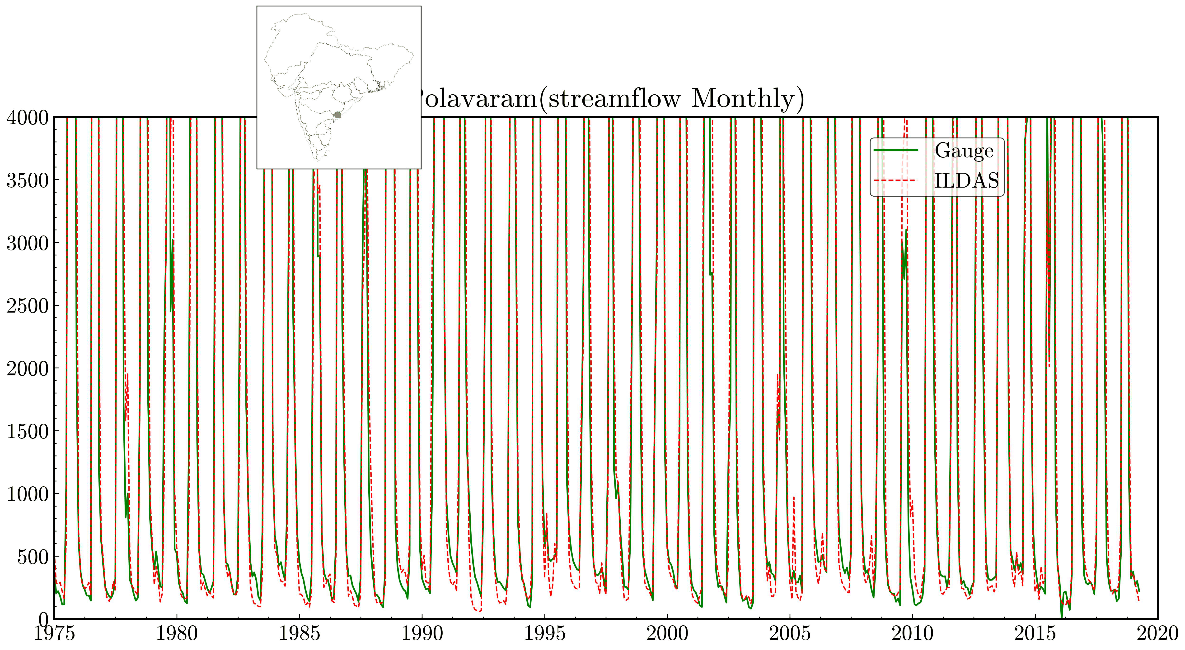
Results – Streamflow GIFS (40 station of higher correlation)

Slide 38
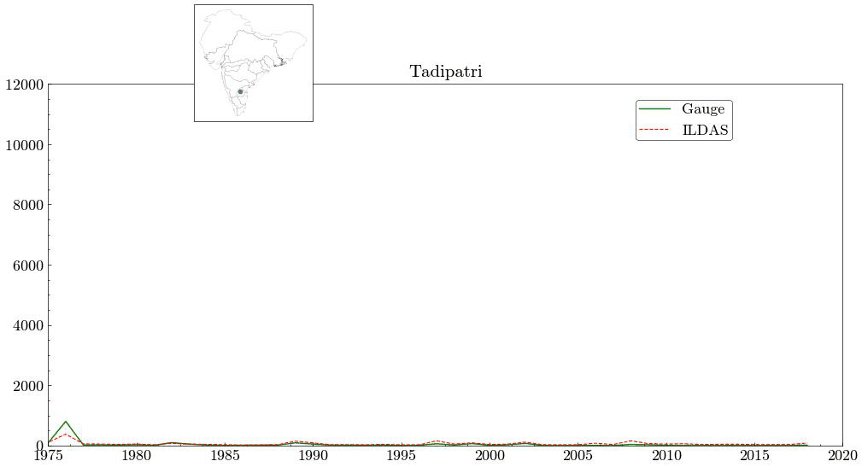
Results – Flood flow GIFS (40 station of higher correlation

Slide 39
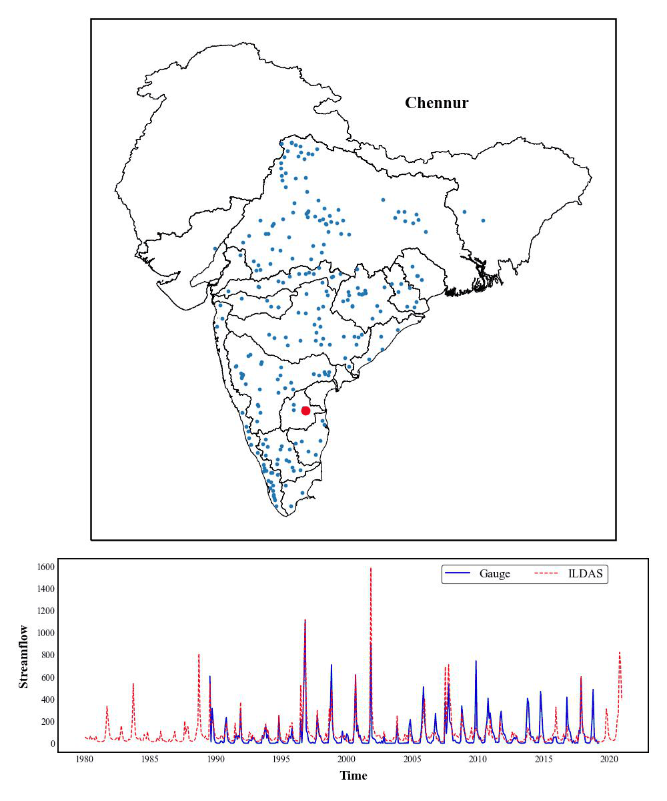
Results – Flood flow GIFS (40 station of higher correlation

Slide 40
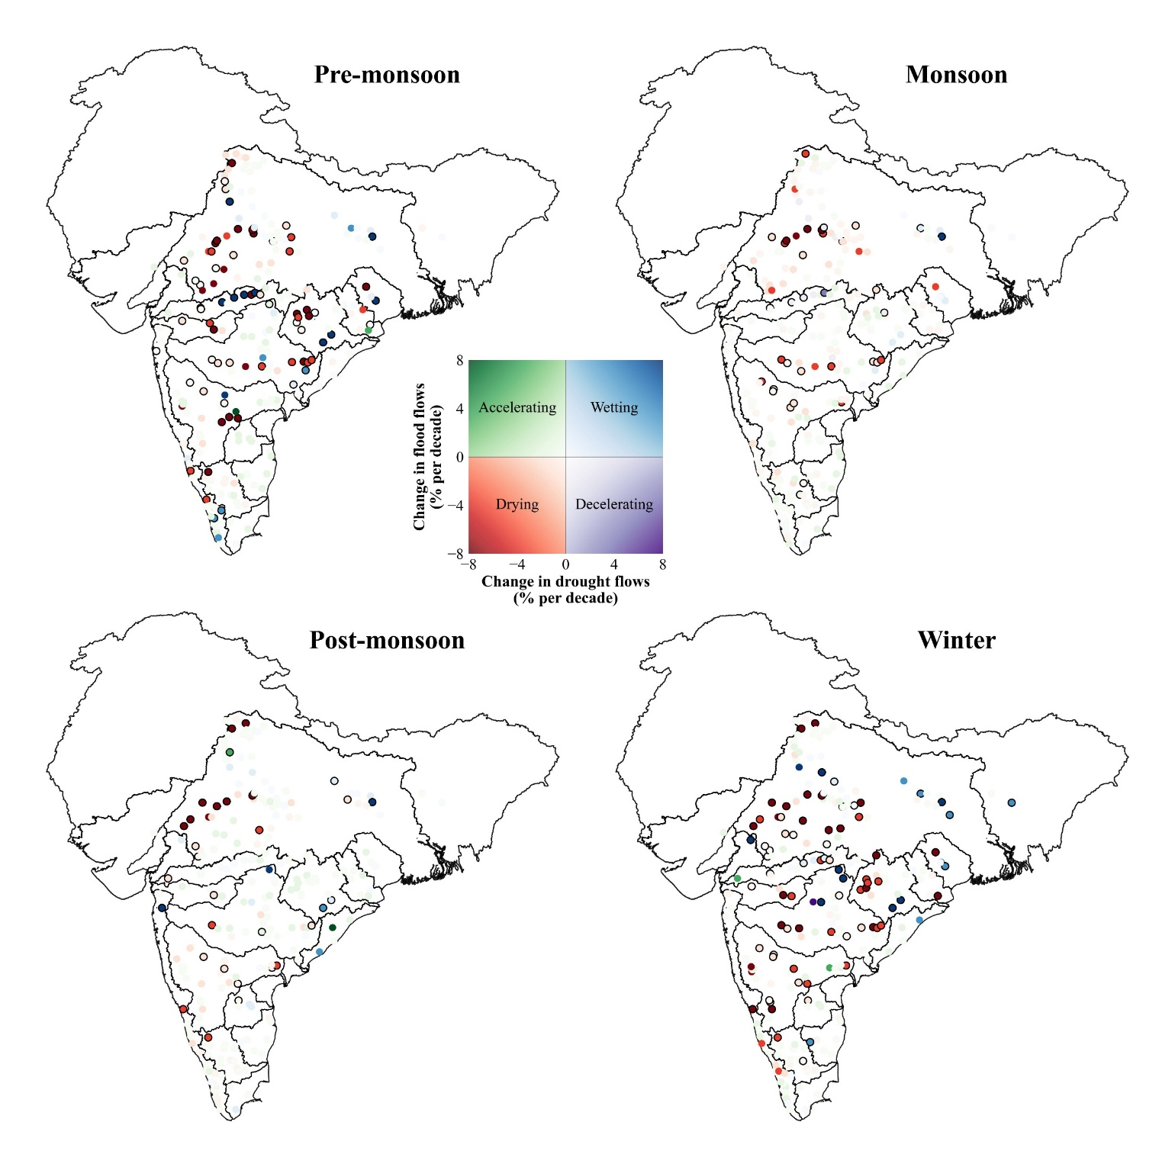

Slide 41
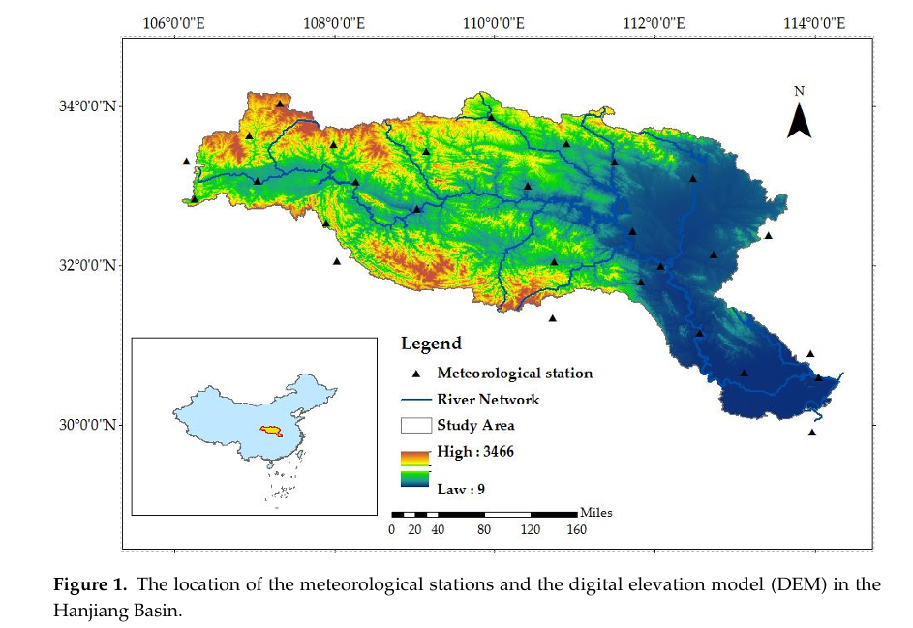
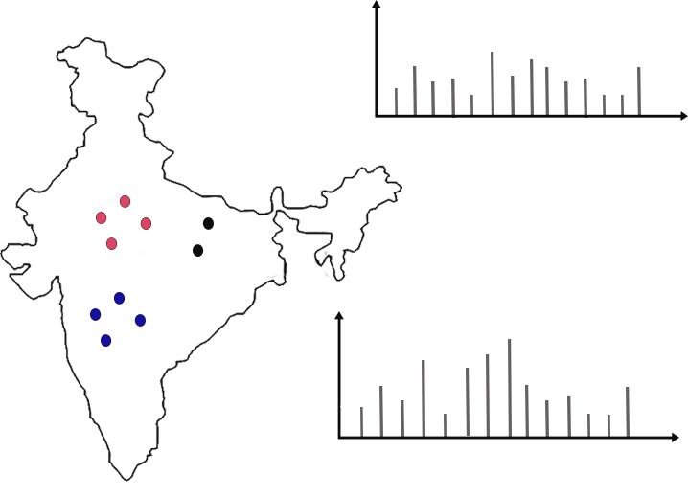
Discussion
(1) More independent index
We need to add more independent indices
Seasonality index (Apportionment Entropy (AE))

Slide 42
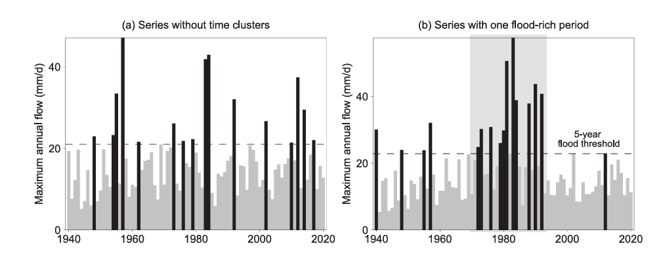
Discussion
(2) Flood rich – Drought rich
Flood‐rich and drought‐rich periods are defined by when the occurrence of floods and droughts within a time window deviates from a reference condition of independently and identically distributed series

Slide 43
METHODOLOGY SCRAP
Develop a consistent index which can capture both flood and drought
Identification of flood-drought transition events over different basins of India (SWAP, EDI)
Investigate the drivers of flood-drought transition
Merge the concepts of Zhao et al., 2020 (flood-drought transition) and Brunner et al., 2020 (dependency)
We use our 3d framework to capture spatio-temporal events (May be this time use a cnn-lstm framework to capture the spatio-temporal drought)
So AI method to capture drought-flood patterns
Findings
A consistent index and an adequate timescale is very important (2-4 week)
HydroSense Lab, IIT Delhi

Slide 44
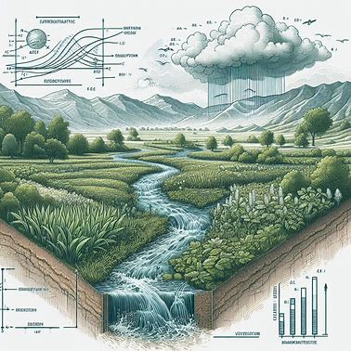
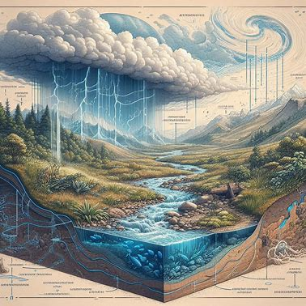
Ideas
Stream flow = atmosphere + land surface
Precipitation is a highly localized and complex phenomenon. So atmosphere variables give a stable quantity to study the long term variability of streamflow
Atmosphere condition and land surface conditions are related
For a particular region, which factor contribute more to streamflow variability : 1. Atmosphere variation
2. Land surface variation
Land alteration

Slide 45
Continuation
Some Indices explored : SPESMI (Standardized Precipitation PET Soil moisture index), SWAP
Findings
A consistent index and an adequate timescale is very important (2-4 week)
HydroSense Lab, IIT Delhi

Slide 46
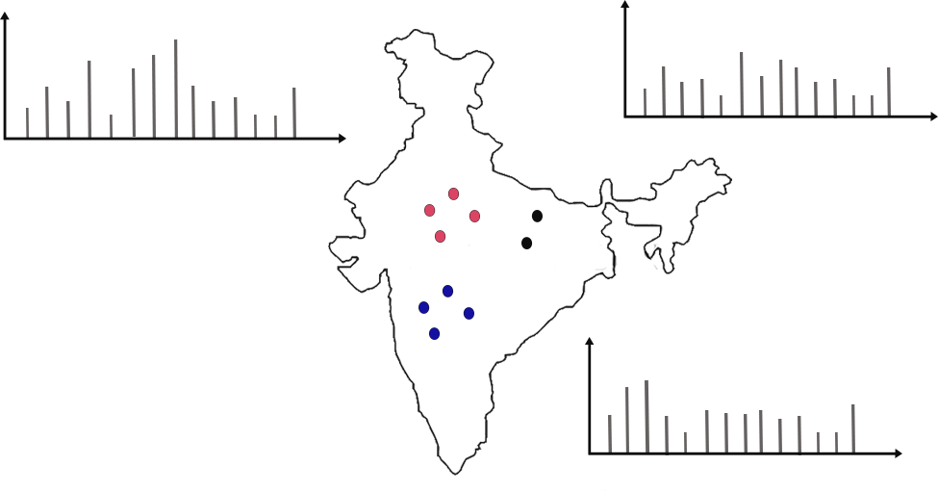
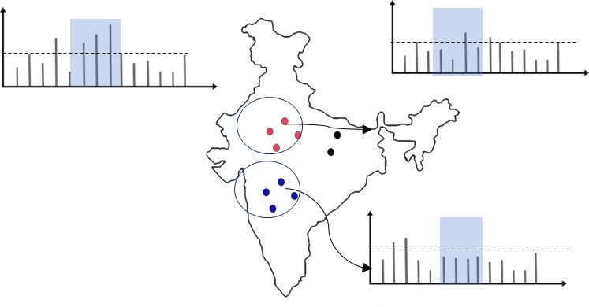
Scopes

